Slide 1
Blue team
The fun parts
- Juha Leivo

Slide 2
Agenda
Introduction
Why this talk
Defining fun parts
Roles in current digital defense doctrine & timeline
Brief tales on different roles

Slide 3
Juha Leivo
12 years in security area
Nokia
Microsoft
Nixu
Currently senior security consultant at Nixu doing DFIR
Somewhat certified: CISSP, GCFA
Still "Doing some Krav Maga" … 18 years training, 7 years teaching.
Notes:
Giac Certified Forensic Analyst

Slide 4
Why this talk
When I started getting bored with building secure systems I looked at what is in the security field and all I saw has hacking or “red teaming”
That’s where I went, I got Certified Ethical Hacker –certificate to start with something.
But I’m a defensive, a nice guy, a blue guy at heart. Hacking is truly interesting, but my skillset does not make hacking web applications easy.
You know its red versus blue, but what does blue do?

Slide 5
Why is this talk?
Blue builds defenses (that red breaks). Blue analyses defenses (audits).
Today blue team is not passive, if it ever was. Today’s defensive doctrine is active.
This presentation is meant to raise awareness of the interesting roles in team Blue.
Unlike in pentesting or ethical hacking there is no disclosures of breaches. There are few if any talks in conferences about cool findings, tools or tricks done by Blue team.

Slide 6
Defining fun parts

Slide 7

Defining fun parts
DFIR (Digital Forensics, Incident Response)
I am excluding front line monitoring and response, first lines of Security Operations Center (SOC)
We will be looking at the deep technical roles working with / behind SOC

Slide 8
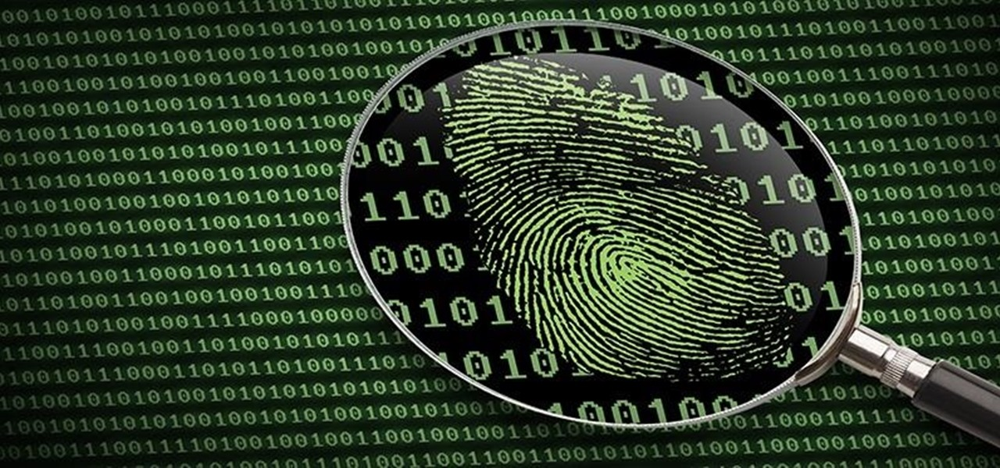
(DIGITAL) Forensics
Forensics is discovering evidence of action in various digital sources.
Goal is to answer to questions
What, Where, When, Who, Why and How
Todays approach is to build a timeline of events that happened and deduct answers from that
In pratice we do mainly disk or memory image forensics.
Different areas of forensics
Memory
Storage/Disk
Network
Mobile device
Notes:
What, Where, When did it take place?
We think we know
How did it happen?
We are going to find out
Why did that happen?
Motive - Purpose
Clue to who
Who was involved?
Clue to why

Slide 9
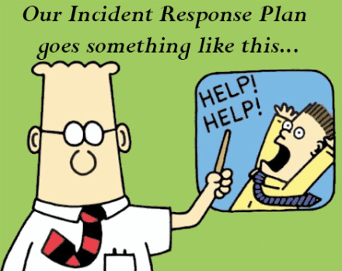
Incident Response
Incident response is responding to identified security breach and restoring system functionality
Usually divided in to six phases (based on NIST SP 800-61 (Computer Security Incident Handling guide)
Actual response phase is four phases
Incident response phases
Preparation
Identification
Contaiment
Eradiction
Recovery
Lessons learned

Slide 10
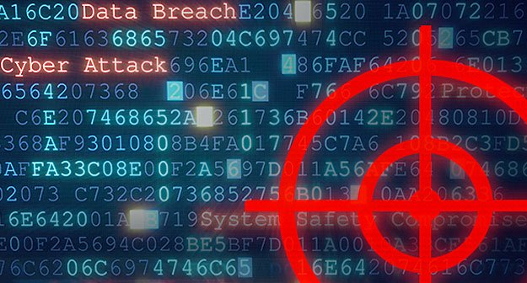
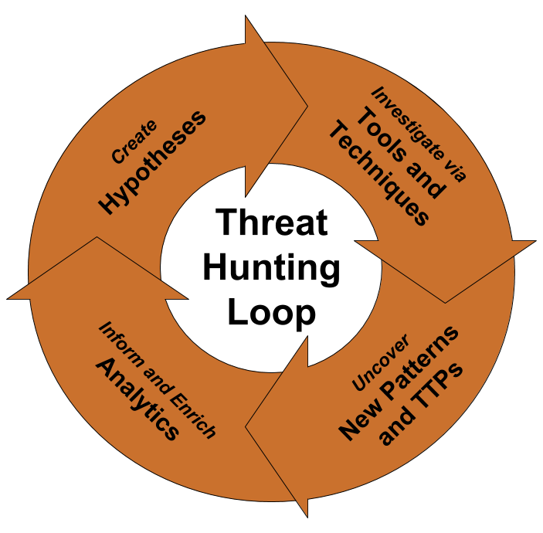
Threat hunting
What do DFIR guys do when they are bored?
THEY HUNT!
Threat hunting is looking for the unseen attacker in the systems
Requires threat intelligence of some sort

Slide 11
current digital defense doctrine & timeline with roles

Slide 12
Defense doctrine*
Defense will not hold forever, someone will breach our systems
Minimize damage
React fast
Improve defense
* doctrine
noun: doctrine; plural noun: doctrines
a belief or set of beliefs held and taught by a group.

Slide 13
I am convinced that THERE ARE ONLY two types of companies: those that have been hacked and those that will be. And even they are converging into one category: companies that have been hacked and will be hacked again. -
FBI Director Robert S. Mueller, III (March 01, 2012)

Slide 14

Timeline
Breach – moment where attackers gain foothold in the system
Detection – moment where owners of the system detected the breach
Breach
Detection
System OK
Threat hunting
Incident Response
Forensics

Slide 15
Brief tales on different roles
So what do you really do?

Slide 16
Forensics - setup
You got five days, two disk images, breach was on 23.04.2018
Attackers encrypted systems, demanded ransomware.
Answer the questions
What – Encrypted systems
When – 23.04.2018
Where – Multiple systems, during IR we deducted these two to be patient zero.
Why – Ransom
Who – Most like will not be known
How – Start working!

Slide 17
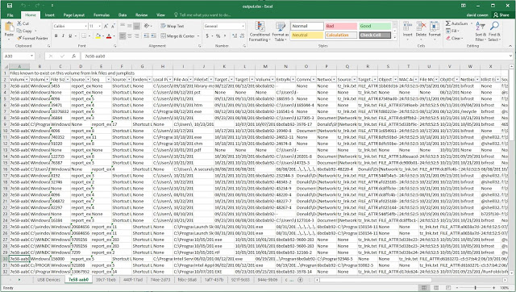
Forensics – in practice
Read logs, look for odd things, look at file system data
In practice, read a big ass excel and color it
Write a report based what you can see, state what you can’t see.

Slide 18
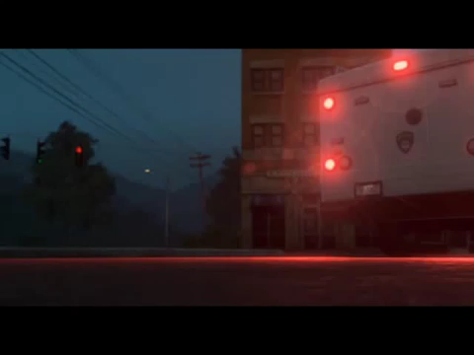
Incident response - setup
Ring, ring. Who is it? Destiny?! I've been expecting your call. – Rhino the hamster, movie Bolt
SOC calls, customer has detected a program on their file share. It can’t deleted. If you delete it, it comes back. So far it has been reported by single administrator. When they used their “Next-Generation Antivirus” software, they detect it on multiple users.
Customer asks: “What do we do? What does that program do?”

Slide 19
Incident response – in practice
Pour yourself a drink. Put on some lipstick and calm yourself (adaptation of Elizabeth Taylor’s quote)
Identify the problem – run the malware in a Sandbox, observe its behavior in target systems. Find ways to find the malware (Network connections? File name? Develop Indicators Of Compromise (IOC)). Identify all instances of the malware
Contain the malware, prevents its spread (sinkhole DNS, firewall rules, block binary, contact AV vendor to create hashes for the malware)
Remove the malware, develop removal and check tools. Proof yourself wrong and find that malware again!
Recover any damage done and to normal usage. Change all passwords present on any of the systems.

Slide 20
Threat hunting - SEtup
You have no forensic work, you got no IR case on going.
Your manager looks at you and states DO SOMETHING USEFUL!
You constantly follow security news and couple of hacker blogs where they talk about new ways of breaking systems

Slide 21
Threat hungting in practice
Look at a new sexy/a good old method method developed by someone
Develop ways to detect it with the tools you have in disposal
Start looking for it in customer systems

Slide 22
My work, as blue team player
20 % Incident Response
10-50 % Forensics / threat hunting
Rest is consulting work for customers
Interested? https://nixu.com/career

Slide 23
Thank you!
Questions?

